Slide 1
Learning Algorithm Implementations Inferring Rudimentary Rules and Decision Trees
MAS DSE 220
April 2015

Slide 2
Learning About Outcomes
Functions
Outcome = Function of Attributes
Sometimes functions are hard to interpret and describe
Sometimes we can describe and interpret functions as concepts or rules
Sometimes we can more directly learn simple descriptions

Slide 3
Basic Methods
Nearest Neighbor (instance based or lazy learner)
1R (rule learner)
Naïve Bayes (a statistical rule)
Decision Tree (divide and conquer)
Hands-on Decision Trees

Slide 4
Simplicity first
Simple algorithms often work surprisingly well
Different kinds of strategies exist:
One attribute
All attributes - equal importance
A linear combination (ie linear function)
Different kinds of conceptual descriptions
An instance-based representation
Simple logical structures
Notes:
1R is a simple, cheap method
that often comes up with quite good rules for characterizing the structure in
data. It turns out that simple rules frequently achieve surprisingly high accuracy.
Perhaps this is because the structure underlying many real-world datasets
is quite rudimentary, and just one attribute is sufficient to determine the class
of an instance quite accurately. In any event, it is always a good plan to try the
simplest things first.

Slide 5
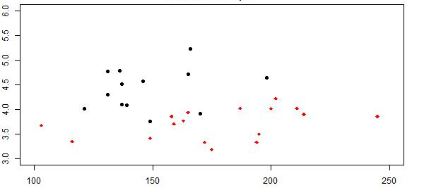
1 Nearest Neighbor
Instance Based Learning: Given new data point, classify by Nearest Neighbor’s class
(depends on distance metric, so scale variables)
Losing teams
ERA
*
Winning teams
Number of Team HRs 2012
(not well scaled, dominates ERA)

Slide 6
1NN issue
Idea: 1 NN might be too sensitive, maybe use k NN
ERA
*
Number of Team HRs 2012

Slide 7
1NN issue
Idea: take most common outcome from k NNs
(note: k=all points is just mean)
ERA
*
Number of Team HRs 2012

Slide 8
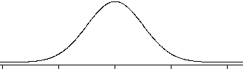
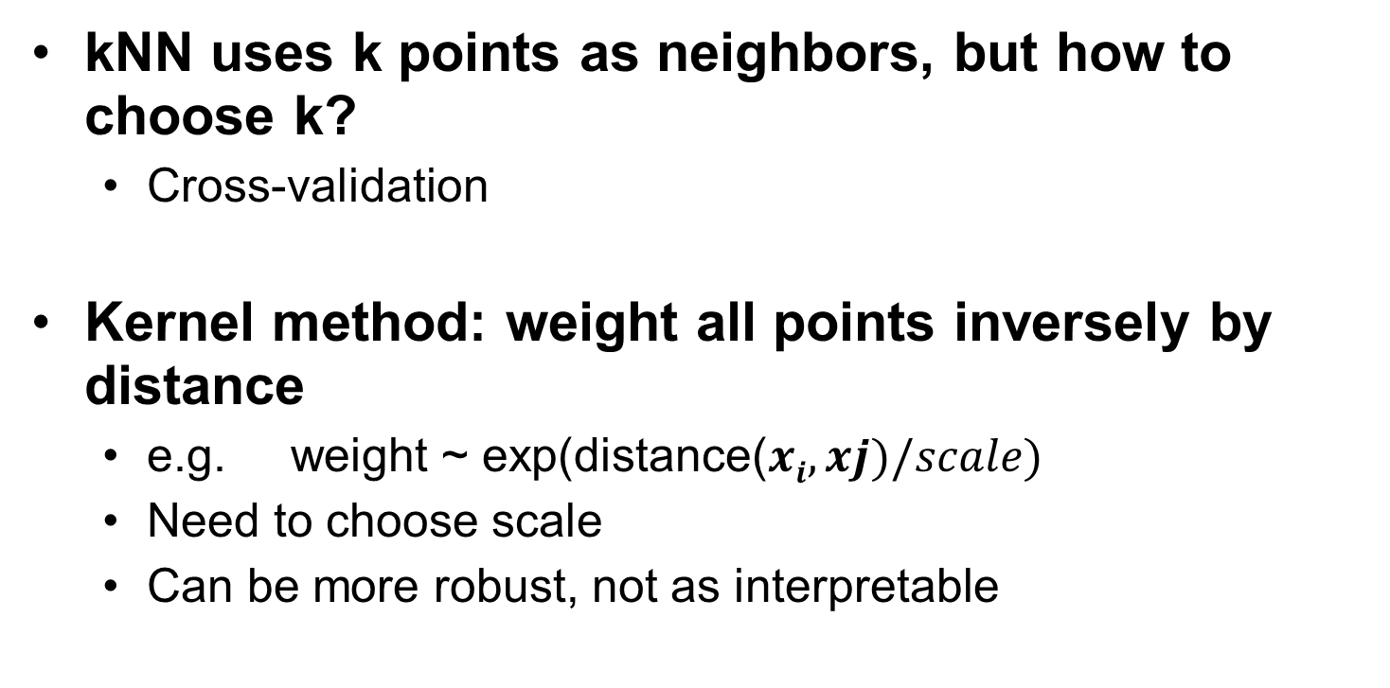
kNN
kNN uses k points as neighbors, but how to choose k?
Cross-validation
Kernel method: weight all points inversely by distance
e.g. weight ~ exp(distance($xi,xj)/scale)$
Need to choose scale
Can be more robust, not as interpretable
Gaussian
scale
0

Slide 9
Rudimentary rules
1R: learns a 1-level decision tree
Set of rules that all test on one particular attribute
Basic version
One branch for each of the attribute’s values
Each branch assigns most frequent class
Error rate: proportion of instances that don’t belong to the majority class of their corresponding branch
Choose attribute with lowest error rate
Notes:
The idea is this: we make rules that test a single attribute and branch accordingly.
Each branch corresponds to a different value of the attribute. It is obvious
what is the best classification to give each branch: use the class that occurs most
often in the training data. Then the error rate of the rules can easily be determined.
Just count the errors that occur on the training data, that is, the number
of instances that do not have the majority class.
Each attribute generates a different set of rules, one rule for every value
of the attribute. Evaluate the error rate for each attribute’s rule set and choose
the best. It’s that simple!

Slide 10
Pseudo-code for 1R
For each attribute
For each value of the attribute make a rule:
count how often each class appears
find the most frequent class
assign that class to this attribute-value
Calculate the error rate of the rules
Choose the rules with the smallest error rate

Slide 11
Weather Data Set

Slide 12
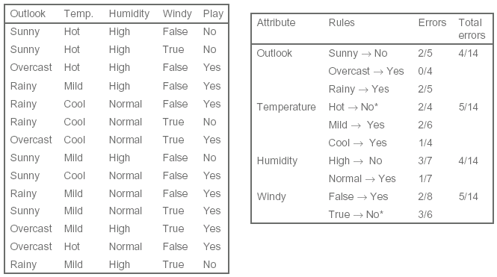

Slide 13
Summary
1R was described in a paper by Holte (1993)
16 datasets
Minimum number of instances was set to 6
1R’s simple rules performed not much worse than much more complex decision trees
“Simplicity first” pays off!

Slide 14
Statistical modeling
“Opposite” of 1R: use all the attributes
Two assumptions: Attributes are
equally important
statistically independent
Knowledge about the value of a particular attribute doesn’t tell us anything about the value of another attribute (if the class is known)
Assumptions that are almost never correct
scheme works well in practice!
Notes:
The 1R method uses a single attribute as the basis for its decisions and chooses
the one that works best. Another simple technique is to use all attributes and
allow them to make contributions to the decision that are equally important and
independent of one another, given the class. This is unrealistic, of course: what
makes real-life datasets interesting is that the attributes are certainly not equally
important or independent. But it leads to a simple scheme that again works surprisingly
well in practice.

Slide 15
Weather Data Set

Slide 16
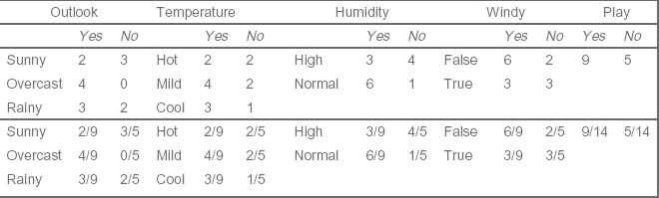
Weather Data Counts and Probabilities
Notes:
shows a summary of the weather data obtained by counting how
many times each attribute–value pair occurs with each value (yes and no) for
play. For example, you can see from Table 1.2 that outlook is sunny for five examples,
two of which have play = yes and three of which have play = no. The cells
in the first row of the new table simply count these occurrences for all possible
values of each attribute, and the play figure in the final column counts the total
number of occurrences of yes and no. In the lower part of the table, we rewrote
the same information in the form of fractions, or observed probabilities. For
example, of the nine days that play is yes, outlook is sunny for two, yielding a
fraction of 2/9. For play the fractions are different: they are the proportion of
days that play is yes and no, respectively.

Slide 17

A new day to be classified

Slide 18
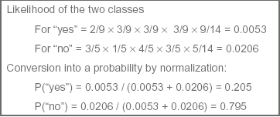
Likelihood of the New Day Outcome
Notes:
Now suppose we encounter a new example with the values that are shown in
Table 4.3. We treat the five features in Table 4.2—outlook, temperature, humidity,
windy, and the overall likelihood that play is yes or no—as equally important,
independent pieces of evidence and multiply the corresponding fractions.
Looking at the outcome yes gives:
The fractions are taken from the yes entries in the table according to the values
of the attributes for the new day, and the final 9/14 is the overall fraction
likelihood of yes = 2 9 ¥ 3 9 ¥ 3 9 ¥ 3 9 ¥ 9 14 = 0.0053.
representing the proportion of days on which play is yes. A similar calculation
for the outcome no leads to
This indicates that for the new day, no is more likely than yes—four times more
likely. The numbers can be turned into probabilities by normalizing them so
that they sum to 1:

Slide 19

Bayes’s rule
Probability of event H given evidence E:
A priori probability of H:
Probability of event before evidence has been seen
A posteriori probability of H:
Probability of event after evidence has been seen
Notes:
This simple and intuitive method is based on Bayes’s rule of conditional probability.
Bayes’s rule says that if you have a hypothesis H and evidence E that bears
on that hypothesis, then
We use the notation that Pr[A] denotes the probability of an event A and that
Pr[A|B] denotes the probability of A conditional on another event B. The
hypothesis H is that play will be, say, yes, and Pr[H|E] is going to turn out to be
20.5%, just as determined previously. The evidence E is the particular combination
of attribute values for the new day, outlook = sunny, temperature = cool,
humidity = high, and windy = true.

Slide 20

Naïve Bayes for classification
Classification learning: what’s the probability of the class given an instance?
Evidence E = instance
Event H = class value for instance
Naïve Bayes assumption: evidence can be split into independent parts
Notes:
Naïve Bayes assumption: evidence can be split into independent parts
(i.e. attributes of instance!)
Pr[E1|yes] x Pr[E2|yes] x Pr[E3|yes] x
Bayes rule naively assumes independence - it is only valid to multiply probabilities when the events are independent

Slide 21


Evidence:
Pr[yes|E]=
Pr[Outlook=Sunny|yes] x Pr[Temperature=Cool|yes] x Pr[Humidity=High|yes] x Pr[Windy=True|yes] x Pr[yes]
Pr[E]
Probabilities for class YES
Notes:
The Pr[yes] at the end is the probability of a yes
outcome without knowing any of the evidence E, that is, without knowing anything
about the particular day referenced—it’s called the prior probability of the
hypothesis H. In this case, it’s just 9/14, because 9 of the 14 training examples
had a yes value for play. Substituting the fractions in Table 4.2 for the appropriate
evidence probabilities leads to

Slide 22
Summary
Naïve Bayes works amazingly well
Violated independence assumption
Because classification doesn’t require accurate probability estimates as long as maximum probability is assigned to correct class
Problem: Adding too many redundant attributes
Example: identical attributes
Conditional Probability visualization:
http://setosa.io/conditional/
Notes:
Naïve Bayes works surprisingly well (even if independence assumption is clearly violated)
Why? Because classification doesn’t require accurate probability estimates as long as maximum probability is assigned to correct class
However: adding too many redundant attributes will cause problems (e.g. identical attributes)
Example:
new attribute with same values at Temp. All of it’s probabilities would be squared
Dependencies between attributes inevitably reduce the power of Naïve beyes to discerns what is going on - take a subset of data

Slide 23
DECISION TREE INDUCTION
Method for approximating discrete-valued functions
robust to noisy/missing data
can learn non-linear relationships
inductive bias towards shorter trees

Slide 24
Decision trees
“Divide-and-conquer” approach
Nodes involve testing a particular attribute
Attribute value is compared to
Constant
Comparing values of two attributes
Using a function of one or more attributes
Leaves assign classification, set of classifications, or probability distribution to instances
Unknown instance is routed down the tree

Slide 25
Decision Tree Learning
Applications:
medical diagnosis – ex. heart disease
analysis of complex chemical compounds
classifying equipment malfunction
risk of loan applicants
Boston housing project – price prediction

Slide 26
DECISION TREE FOR THE CONCEPT “Sunburn”

Slide 27
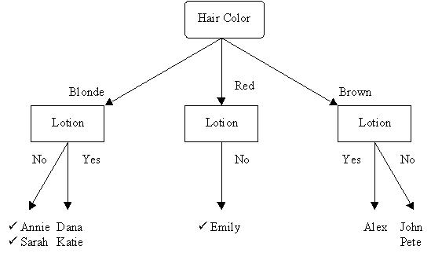
DECISION TREE FOR THE CONCEPT “Sunburn”

Slide 28
DT for Medical Diagnosis and Prognosis Heart Disease
Minimum systolic blood pressure over a 24-hour period following admission to the hospital
<= 91
> 91
Age of Patient
Class 2:
Early death
<=62.5
>62.5
Class 1:
Survivors
Was there sinus tachycardia?
NO
YES
Class 1:
Survivors
Class 2:
Early death
Beriman et. al, 1984
Notes:
Identify patients who are at risk of dying within 30 days from patients who have suffered heart attack and survived at least first 24 hours past admission at UCSD Medical Center (1983)
Diagnosis sometimes difficult: 1. history of characteristic chest pain; 2. Indicative electrograms; 3. Characteristic elevations of enzymes that tend to be released by damaged heart muscle
215 patients 37 died a78 did not
19 included variables for each (noninvasive)
Sinus tachycardia: present if the sinus node heart rate ever exceeded 100 beats per minute during first 24 hours
The sinus node is the normal electrical pacemaker of the heart and is located in the right atrium
Even thought decision trees have been used for a wide variety of problems they are best suited for the classification problems that provide instances of data as attribute-value pairs and the target function has discrete output values.
Not expressive enough for some problems

Slide 29
Occam’s Razor
“The world is inherently simple. Therefore the smallest decision tree that is consistent with the samples is the one that is most likely to identify unknown objects correctly”

Slide 30
Decisions Trees Representation
Each internal node tests an attribute
Each branch corresponds to attribute value
Each leaf node assigns a classification

Slide 31
When to Consider Decision Trees
Instances describable by attribute--value pairs
each attribute takes a small number of disjoint possible values
Target function has discrete output value
Possibly noisy training data
may contain errors
may contain missing attribute values
Notes:
Instances represented by attribute-value pairs
Instances described by a fixed set of attributes(e.g. Temperature) and their values (e.g.hot)
Best scenario: Attribute takes on a small number of disjoint possible values (e.g. hot, mild, cold)
Target function has discrete output values
Disjunctive hypothesis may be required
Simplest case: Only two possible classes (Boolean classification)
Noisy training data
Both in classifications of the training examples and attribute values that describe examples
Missing values

Slide 32
Weather Data Set-Make the Tree!

Slide 33
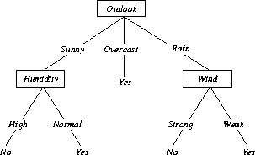
DECISION TREE FOR THE CONCEPT “Play Tennis”
[Mitchell,1997]
Mitchell, 1997

Slide 34
Constructing decision trees
Normal procedure: top down in recursive divide-and-conquer fashion
First: attribute is selected for root node and branch is created for each possible attribute value
Then: the instances are split into subsets (one for each branch extending from the node)
Finally: procedure is repeated recursively for each branch, using only instances that reach the branch
Process stops if all instances have the same class

Slide 35
Induction of Decision Trees
Main Recursive loop:
Pick the “best'' attribute to split the data at current decision node, according to some measure
For each value of attribute, create new leaf node descendants of current node
Sort data to new leaf nodes
For each leaf node:
If training examples perfectly classified,
Then STOP
Else Iterate at current leaf node as next decision node

Slide 36
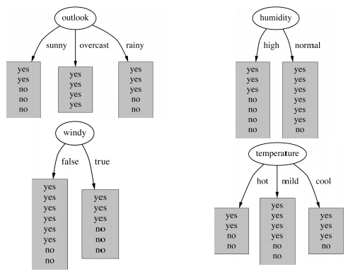
Which is the best attribute?

Slide 37
Attribute selection
How to choose the best attribute?
Smallest tree
Heuristic: Attribute that produces the “purest” nodes
Impurity criterion:
Information gain
Increases with the average purity of the subsets produced by the attribute split
Choose attribute that results in greatest information gain
Notes:
Which is the best attribute?
The one which will result in the smallest tree
Heuristic: choose the attribute that produces the “purest” nodes
Popular impurity criterion:
Information gain
Information gain increases with the average purity of the subsets that an attribute produces
Strategy: choose attribute that results in greatest information gain

Slide 38
Computing information
Information is measured in bits
Given a probability distribution, the info required to predict an event is the distribution’s entropy
e.g. highly predictable events => low entropy
e.g. random probabilities => higher entropy
Formula for computing the entropy for n classes:

Slide 39
Expected information for attribute “Outlook”
“Outlook” = “Sunny”
“Outlook” =“Overcast”
“Outlook” =“Rainy”
Total expected information: is weighted avg. of entropy at each node branch,
Branch probs
are the weights: 5/14 4/14 5/14
Class probs
used for each Entropy: 2/5,3/5 4/4,0/4 3/5,2,5

Slide 40
Computing the information gain
Information gain: information before splitting – information after splitting
Test the Info Gain for outlook at root node:
Gain(“Outlook”)=entropy of classes –
avg. entropy of classes at new leaf nodes
= Ent( 9/14,5/14) –
5/14*Ent(2/5,3/5) + 4/14*Ent(4/4,0/4)+ 5/14*Ent(3/5,2/5)
0.940-0.693 = 0.247 bits
Notes:
Before splitting on Outlook the root had 14 instances 9 -yes and 5 - no
0.247 bits is the informational value of creating a branch of the outlook attribute
Humidity is next best produces a larger daughter node that is almost completely pure

Slide 41
Computing the information gain
Information gain for attributes from weather data:
Gain (“Outlook”) = 0.247 bits
Gain (“Temp”) = 0.029 bits
Gain (“Humidity”) = 0.152 bits
Gain (“Windy”) = 0.048 bits
Notes:
Before splitting on Outlook the root had 14 instances 9 -yes and 5 - no
0.247 bits is the informational value of creating a branch of the outlook attribute
Humidity is next best produces a larger daughter node that is almost completely pure

Slide 42
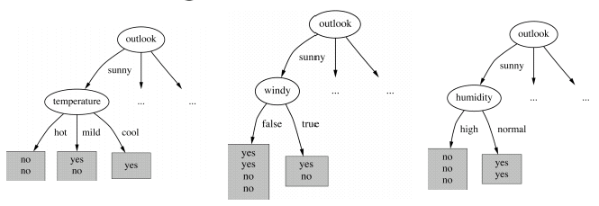
Further splits
Gain (“Temp”)=0.571 bits Gain (“Humidity”)=0.971 Gain(“Windy”)=0.020 bits

Slide 43
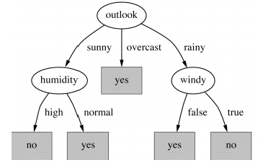
Final product

Slide 44
Purity measure
Desirable properties
Pure Node -> measure = zero
Impurity maximal -> measure = maximal
Multistage property
decisions can be made in several stages
measure([2 ,3,4])= measure([2,7])+(7/9) × measure([3,4])
Entropy is the only function that satisfies all the properties

Slide 45
Other Heuristics for Node Selection
Gini Index over data S: (1 - ∑_{j} p_{j}² )
Similar to behavior to entropy, maximal for random p,
minimal for high p
Average Gini index for new split in S_{i} subsets:
=∑_{i} ∣S _{i} ∣/∣S∣ ⋅ (1 - ∑_{j} p _{j} )
Conditional Tests
Test error before/after each new possible node for statistical significance (pre-prune tree)

Slide 46
Highly-branching attributes
Attributes with a large number of values
example: ID code
Subsets more likely to be pure if there is a large number of values
Information gain biased towards attributes with a large number of values, (especially as leaf node training examples get smaller)
Overfitting

Slide 47
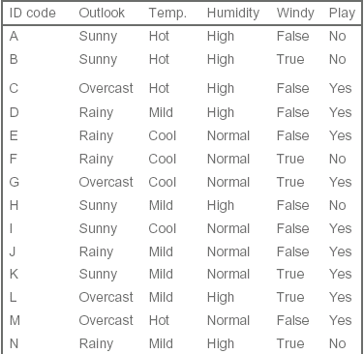
New version of Weather Data

Slide 48
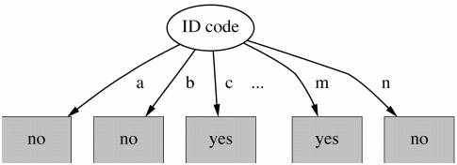
ID Code Attribute Split
Info([9,5]) = 0.940 bits
Notes:
Entropy of split:
⇒ Information gain is maximal for ID code (namely
0.940 bits)

Slide 49
Gain ratio
Modification that reduces its bias
Info Gain / Intrinsic Info
Intrinsic information:
Entropy of attribute based on sample values at that node
(not the class values at leaf node)
e.g. An ID variable will have high intrinsic info, thereby shrinking the Info Gain
It helps usually (but not necessarily)
Notes:
Gain ratio: a modification of the information gain that reduces its bias
Gain ratio takes number and size of branches into account when choosing an attribute, disregarding any info about the class
It corrects the information gain by taking the intrinsic information of a split into account
Intrinsic information: entropy of distribution of instances into branches (i.e. how much info do we need to tell which branch an instance belongs to)

Slide 50
Summary
Algorithm for top-down induction of decision trees
“ID3” was developed by Ross Quinlan
C4.5 incorporate
numeric attributes, missing values, and noisy data
J48 is the WEKA java implementation
CART Breiman, Friedman, Olshen, Stone
Many other variations
Notes:
Divide and conquer approach sometimes called Algorithm for top-down induction of decision trees
(“ID3”) was developed by Ross Quinlan
Gain ratio just one modification of this basic algorithm
Led to development of C4.5, which can deal with numeric attributes, missing values, and noisy data
Similar approach: CART
There are many other attribute selection criteria!
(But almost no difference in accuracy of result.)

Slide 51
Avoid Overfitting
How can we avoid Overfitting:
Stop growing when data split not statistically significant
Grow full tree then post-prune
How to select best tree?
Measure performance over training data
Measure performance over separate validation data set

Slide 52
Pruning
Pruning simplifies a decision tree to prevent overfitting to noise in the data
Pre-pruning:
stops growing a branch when information becomes unreliable
Post-pruning:
discard subtrees if they don’t improve error estimates
Error estimates are derived from cross-validation or statistical assumptions
Post-pruning preferred in practice because of early stopping in pre-pruning
Notes:
Two main pruning strategies:

Slide 53
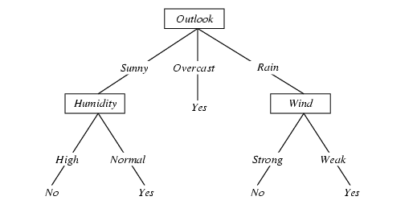
Converting Tree to rules

Slide 54
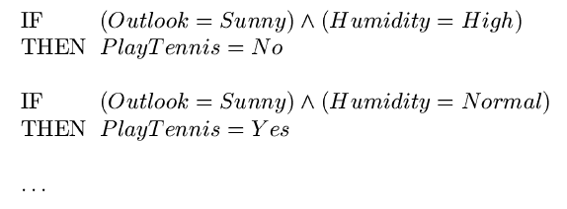
Converting Tree to rules

Slide 55
Thank you!

